Slide 1
Determining Needs in Sales
  Objectives
  Explain why determining needs is an essential step in the sales process
  List three methods for determining needs
Marketing Essentials Chapter 13, Section 13.2

Slide 2

3 Asking Questions

Slide 3
Determining Needs
In this step of the sale, your job is to
uncover the customer’s problems or reasons for wanting to buy
determine those needs so you can offer one or more solutions.
Marketing Essentials Chapter 13, Section 13.2

Slide 4
When to Determine Needs
When to Determine Needs:
as early in the sales process as possible
Retail Selling = immediately after the approach
B2B – During the pre-approach research
Determining the needs of a customer helps a salesperson match those needs with products or services.
Marketing Essentials Chapter 13, Section 13.2

Slide 5
How to Determine Needs
There are three methods used to determine customer needs:
  Observing
  Listening
  Questioning
Marketing Essentials Chapter 13, Section 13.2

Slide 6
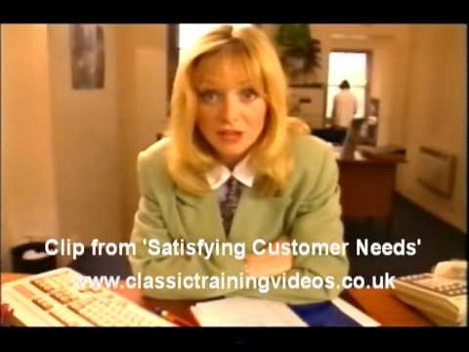
Uncover customer’s needs?

Slide 7

1. Observing
Look for clues about a customer’s mood and interest in a product through nonverbal signs
Nonverbal communication X is expressing oneself without words
Nonverbal Clues can be found in:
  Facial expressions
  Hand motions
  Eye movements
  How long customer looks at a product
Marketing Essentials Chapter 13, Section 13.2

Slide 8

2. Listening
Listening helps you pick up clues to the customer’s needs when asking questions
Listen to
What they say and ask for
what their primary likes are
what problem they are looking to solve
Ironically, listening is the least developed skill amongst salespeople.

Slide 9

3. Asking Questions
How to Determine Needs
Ask general questions
  Ask about the intended use of the product
  Ask any previous experience with it
Build your questions around words
  like who, what, when, where, why, and how
Notes:
Build your questions around words like who, what, when, where, why, and how
If someone was buying a camera, you could ask:
Who will be using the camera?
What type of camera is the person presently using?
How much experience has the person had with cameras?
How many pictures will the person take weekly?

Slide 10

You Try Asking Questions
If someone was buying a camera, you could ask the following (intended use):
You and a partner come up with one question each and enter in packet:
  Who
  What
  When
  Where
  How
Notes:
Build your questions around words like who, what, when, where, why, and how
If someone was buying a camera, you could ask:
Who will be using the camera?
What type of camera is the person presently using?
How much experience has the person had with cameras?
How many pictures will the person take weekly?

Slide 11
Answers Asking Questions
If someone was buying a camera, you could ask the following:
  Who - who will take the photos
  What – what types do you take – still or high action or both?
  When - How often do you take these
  Where – What locations, Inside or outside etc
  How – How familiar are you with cameras. Do you prefer point and click or manual adjustments for better pics?
Notes:
Build your questions around words like who, what, when, where, why, and how
If someone was buying a camera, you could ask:
Who will be using the camera?
What type of camera is the person presently using?
How much experience has the person had with cameras?
How many pictures will the person take weekly?

Slide 12
Stop Teacher will do a group Activity with you at this point.

Slide 13

Questioning Assignment
Get in pairs of 2 - Assign each of you a letter A & B

Slide 14
3 Asking Questions
Two Types of questions:
Open ended questions
Closed ended questions
Notes:
Build your questions around words like who, what, when, where, why, and how
If someone was buying a camera, you could ask:
Who will be using the camera?
What type of camera is the person presently using?
How much experience has the person had with cameras?
How many pictures will the person take weekly?

Slide 15
Open-ended questions X require respondents to construct their own answers - requires more than a yes or no answer
Examples:
“What do you think your leadership team is looking for in a product/service?”
What is the layout of the room your furniture will go in?
What style are you looking for, can you describe it for me?
Generally, open ended questions Start with “where,” “what,” “why,” and “how” questions.

Slide 16
Closed Ended Questions: a question format that limits respondents with a list of answer choices. In sales this is a yes or no answer or a one-word answer
A great way to get a precise answer from your prospect
Great way to understand their wants and needs
Start with the Verb - In general, closed ended questions begin with a verb, such as “are,” “did,” “will,” or “won’t,” “didn’t,” “aren’t,” etc.
An example is, “Are you looking for a specific color?” or “Are you interested in our cookie pizza for $5.00?”

Slide 17
Dos and Don'ts of Questioning
  DO
  Ask open-ended questions that encourage customers to do the talking.
  Ask clarifying closed questions to make sure you understand the customers’ needs.
  DO NOT
  Do not ask too many questions in a row.
  Do not ask questions that might embarrass customers or put them on the defensive.

Slide 18
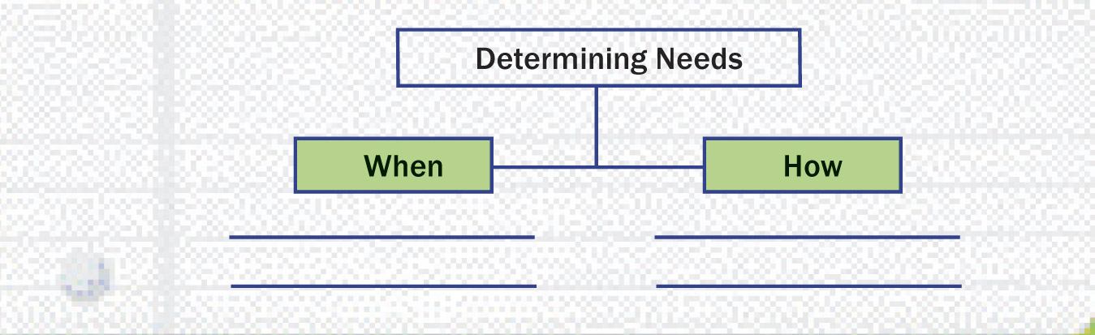
Determining Needs in Sales
Study Organizer
Prepare a chart like this one to review when and how to determine needs in the sales process.
Marketing Essentials Chapter 13, Section 13.2

